Slide 1
Everybody takes a look!
I have a new blue marker.
Cool, right?

Slide 2
Classroom English

Slide 3
Raise your hands.

Slide 4
Put your hands down.

Slide 5
Take out your book.

Slide 6
Put away your book.

Slide 7
Open your book.

Slide 8
Close your book.

Slide 9
Come here, please.

Slide 10
Go back to your seat.

Slide 11
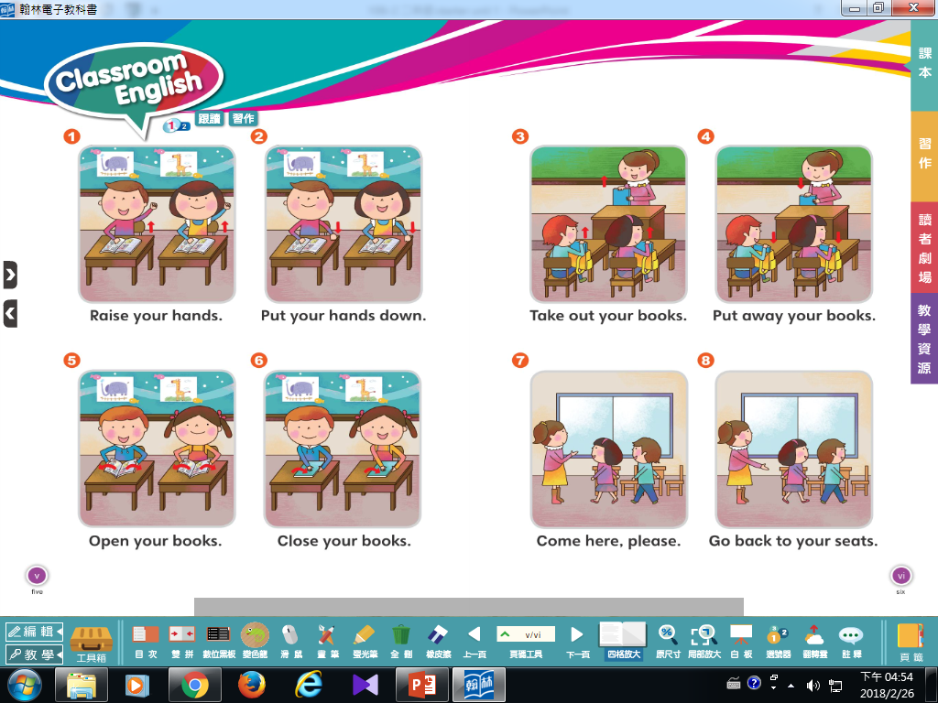

Slide 12
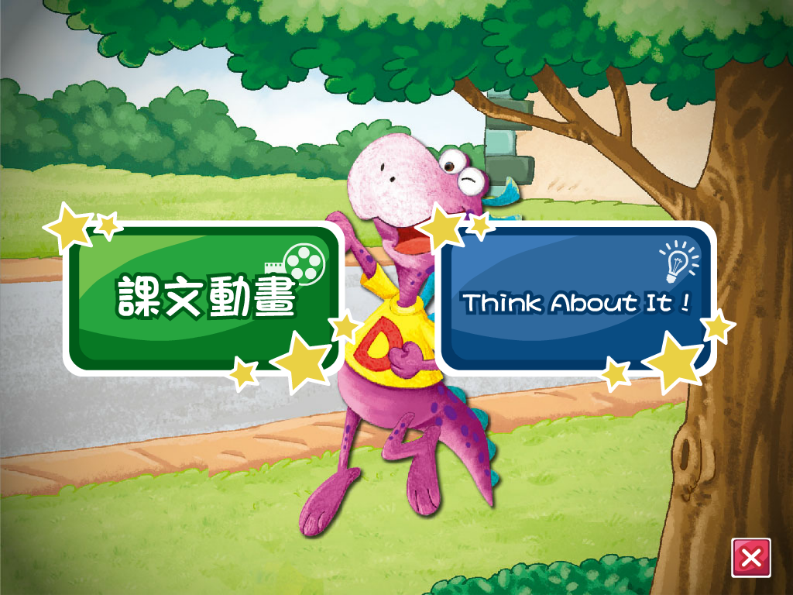

Slide 13
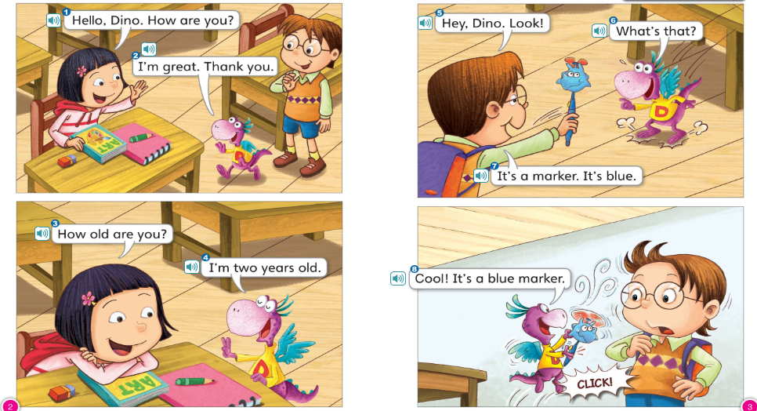

Slide 14
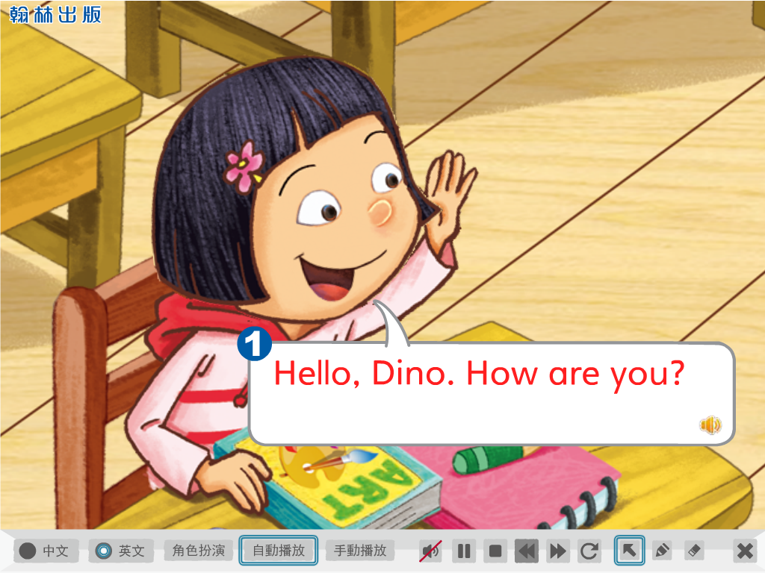
Let’s be voice dubbers!

Slide 15
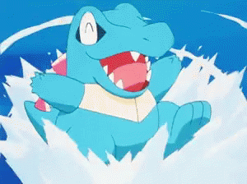
How are you?
I’m not so good.
I’m great!

Slide 16
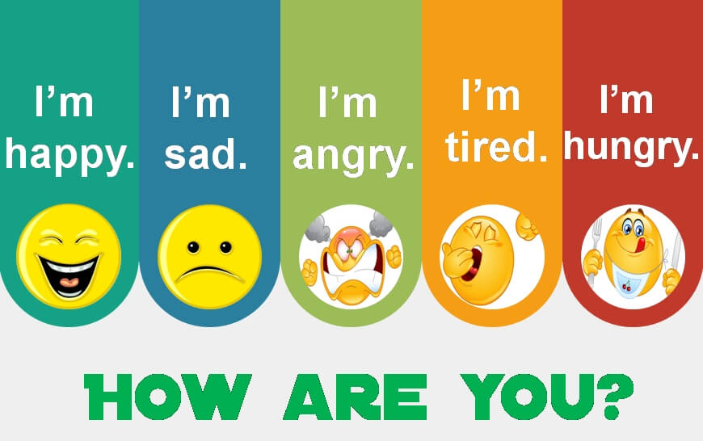

Slide 17
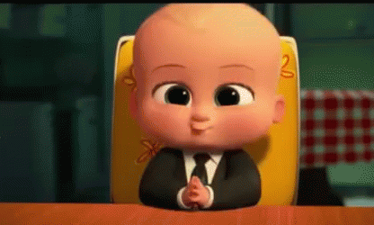
How old are you?
I’m one year old.

Slide 18
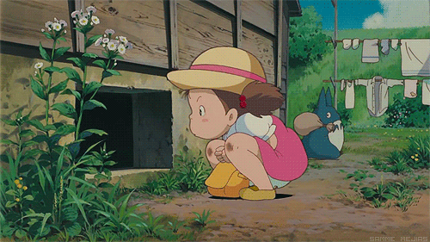
How old are you?
I’m four years old.

Slide 19
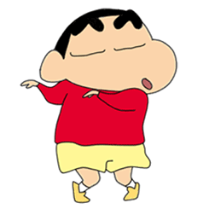
How old are you?
I’m five years old.

Slide 20
How old are you?
I’m seven years old.

Slide 21
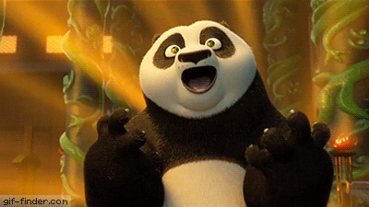
How old are you?
I’m ten years old.

Slide 23
What’s this?
What’s that?

Slide 25
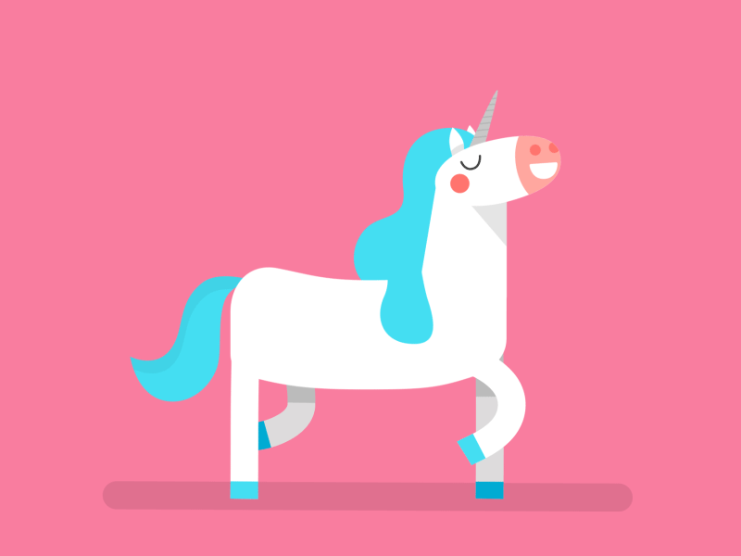
What color is this?

Slide 26
It’s blue.

Slide 27
It’s green.

Slide 28
It’s red.

Slide 29
It’s black.

Slide 30
It’s pink.

Slide 31
It’s yellow.

Slide 32
It’s white.

Slide 33
It’s orange.

Slide 34
It’s grey.

Slide 35
It’s purple.

Slide 36
It’s brown.

Slide 37
It’s a blue cup.

Slide 38
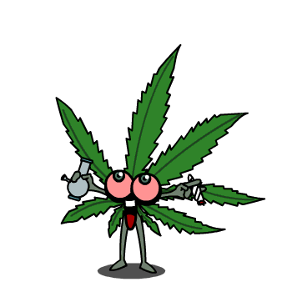
It’s a green leaf.

Slide 39
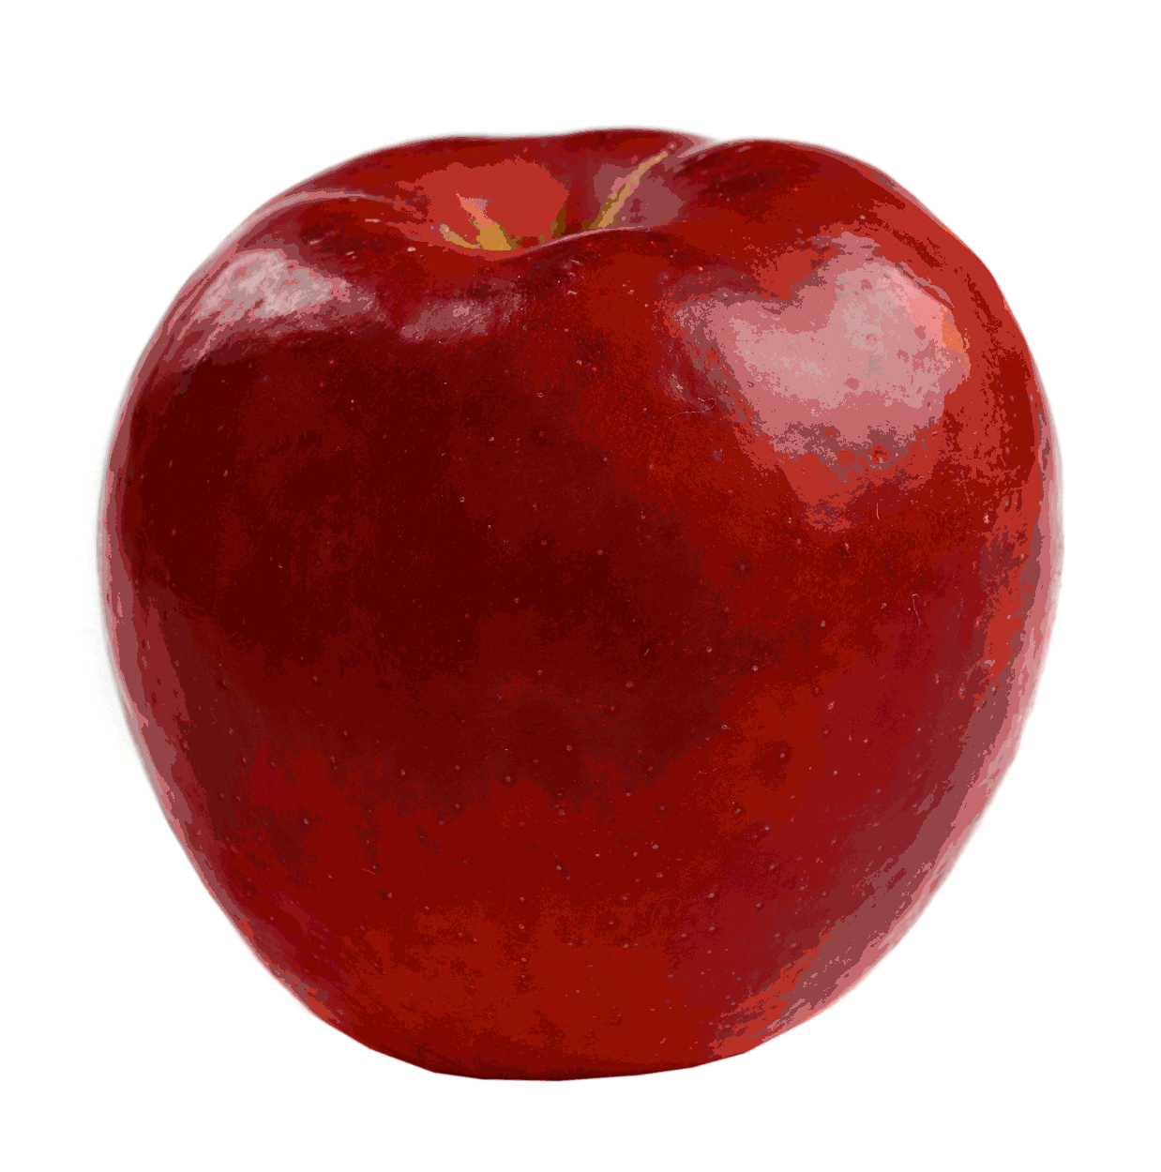
It’s a red apple.

Slide 40
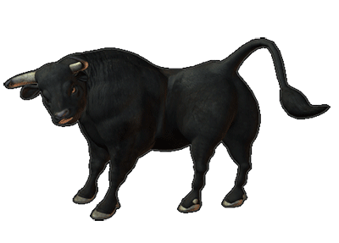
It’s a black ox.

Slide 41
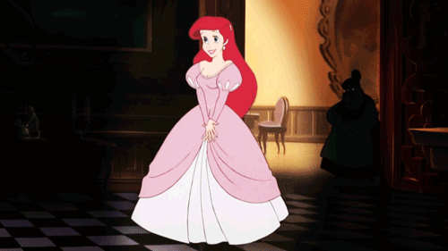
It’s a pink dress.

Slide 42
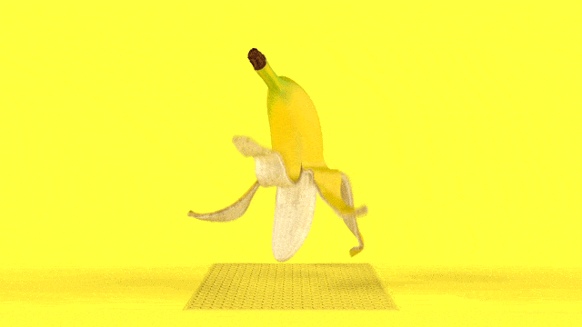
It’s a yellow banana.

Slide 43
It’s a white bear.

Slide 44
It’s an orange car.

Slide 45
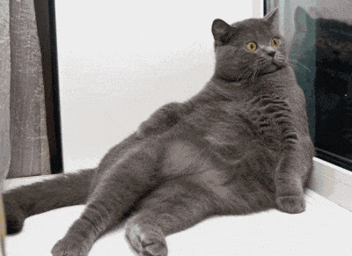
It’s a grey cat.

Slide 46
It’s a brown box.

Slide 47
It’s a purple book.

Slide 48
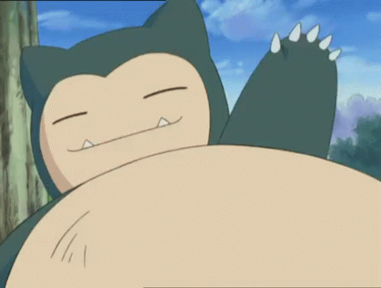
【第一週英語作業】
1.聆聽和跟讀英語 CD1 2~8首
2.完成英語學習單(雙面)。

Slide 49
班級
座號
姓名

